Slide 1
CUSTOMER-RETENTION-DATASET
A CASE STUDY

Slide 2
DATA SOURCES AND INFO:
1.There are two sheets one is detailed and second is encoded in the excel.
2.Using data.shape()we get dimensions i.e. 269 Rows and 71 Columns.
3.Using data.head()we display the first five rows of the dataset.
4.Using data.info()we get info of the features of the dataset and we get “70” object type features and 1 “int 64” type features.

Slide 3
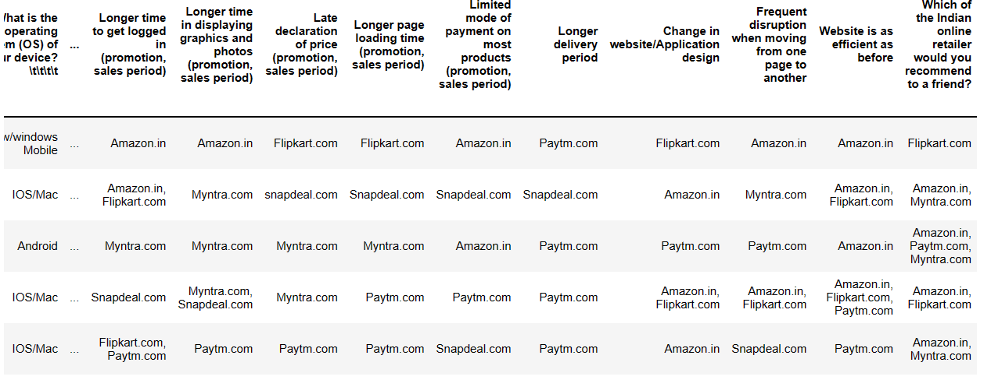
Load the dataset from excel

Slide 4
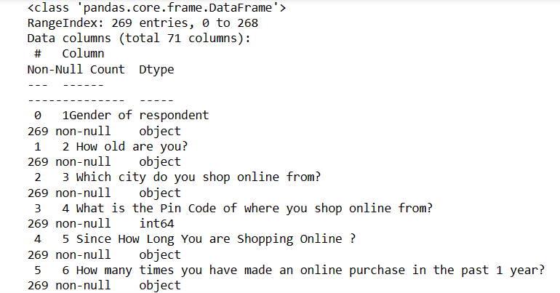
DATASET INFO:(269 Rows And 71 Columns

Slide 5
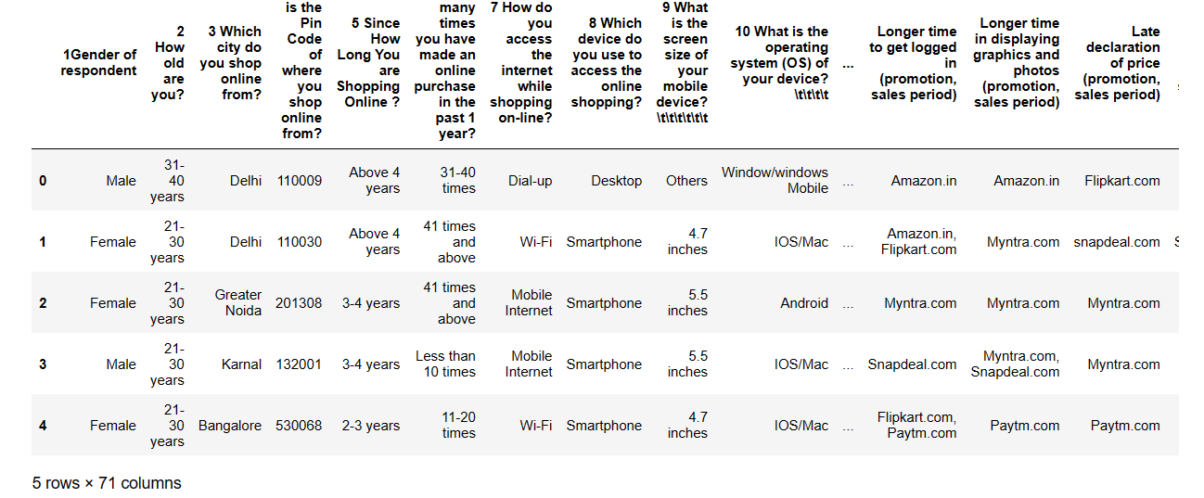
Only extrct top 5Rows:data.head()

Slide 6
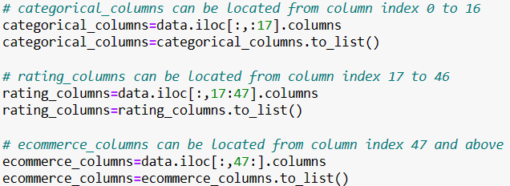
There are a huge no of features,it makes sense to devide the data into three categories:-

Slide 7
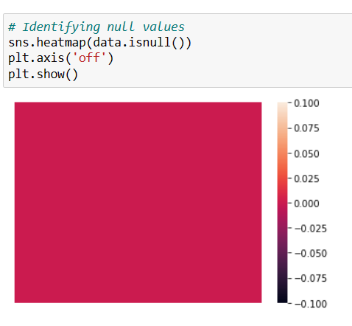
CHECKING FOR THE NULL VALUES:- From the plot we can see there are no null values present in the Dataset

Slide 8
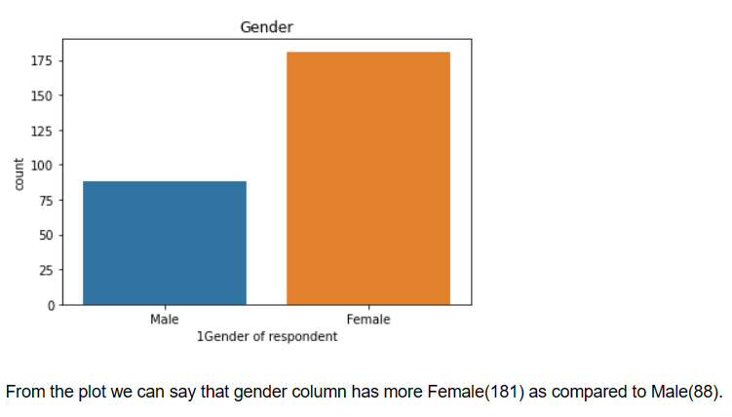
DATA VISUALIZATION:

Slide 9
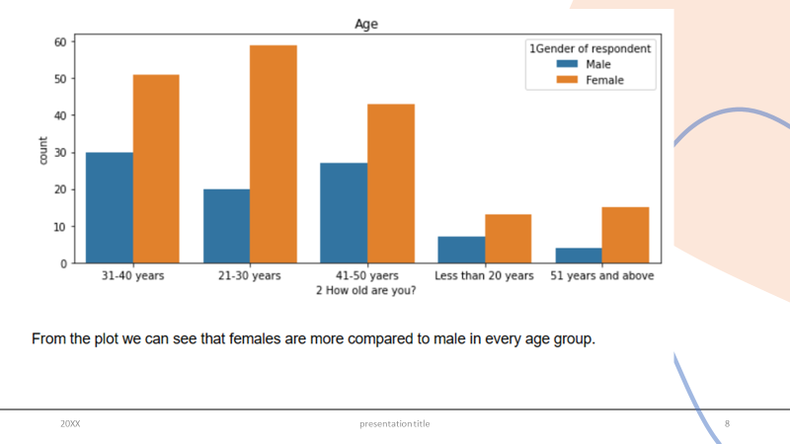

Slide 10
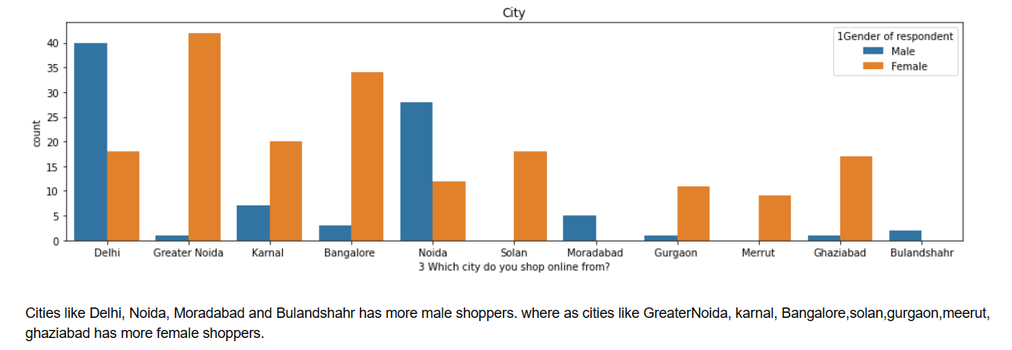

Slide 11
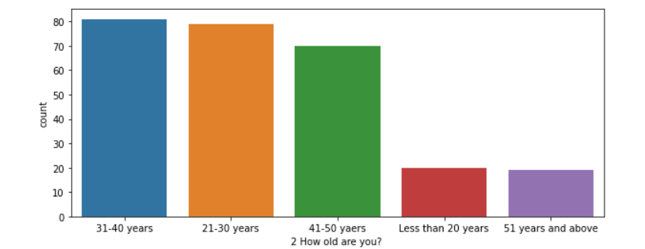
UNIVARIATE ANALYSIS:

Slide 12
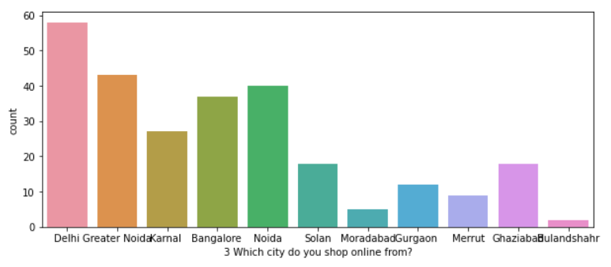

Slide 14
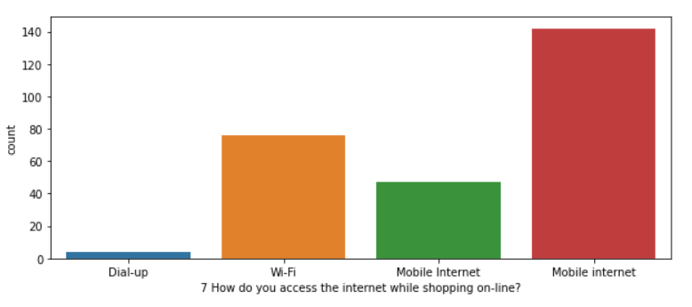

Slide 15
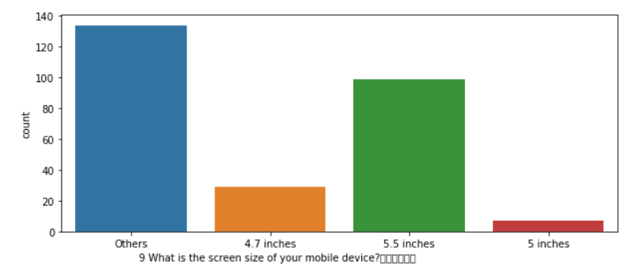

Slide 16
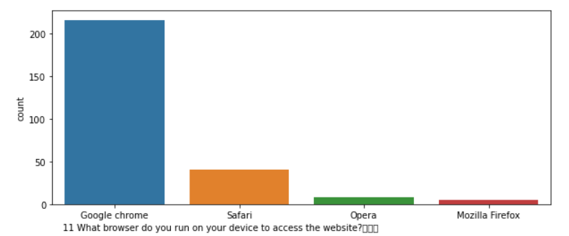

Slide 17
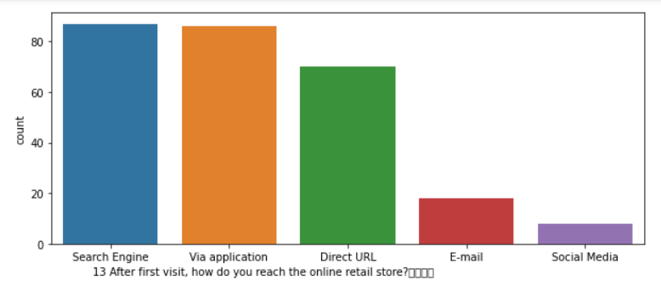

Slide 18
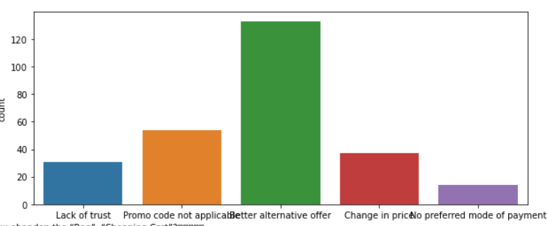

Slide 19
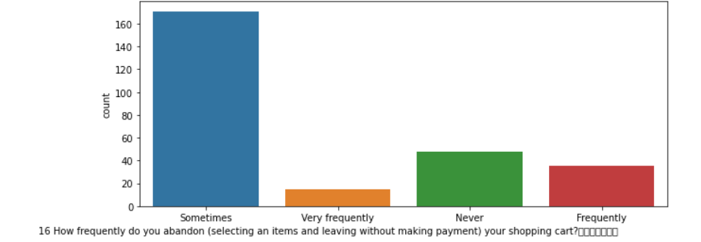

Slide 20
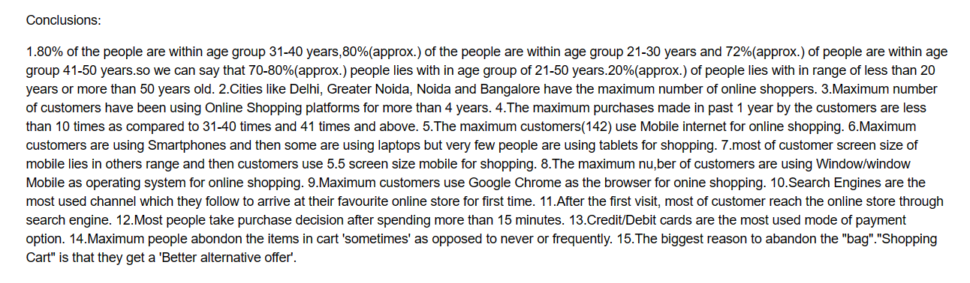
OBSERVATIONS:

Slide 21
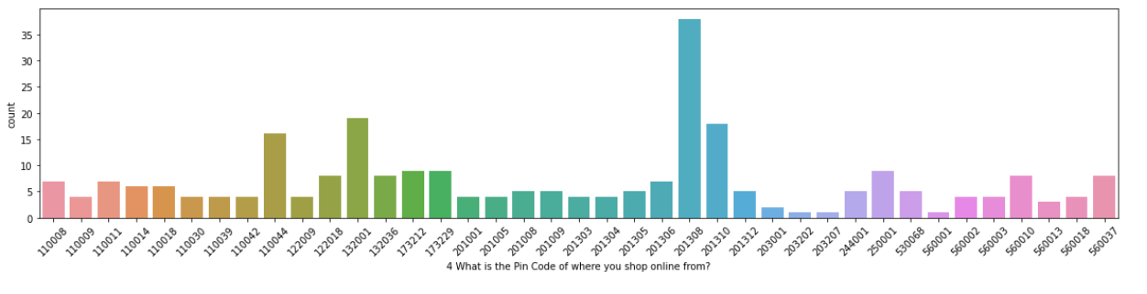
VALUE COUNT FOR PINCODE COLUMN:

Slide 22
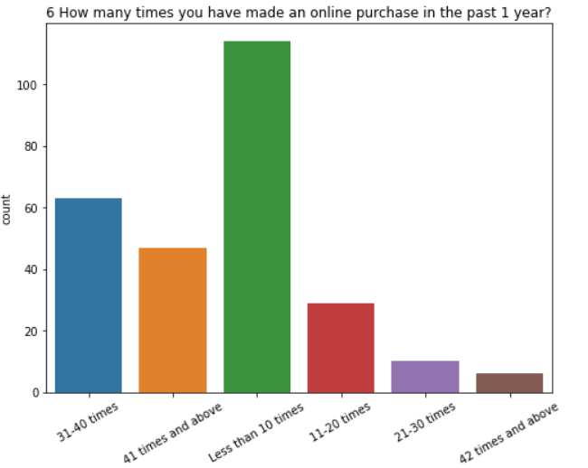
CHECKING HOW MANY TIMES MADE AN ONLINE PURCHASE IN THE PAST 1 YEAR:

Slide 23
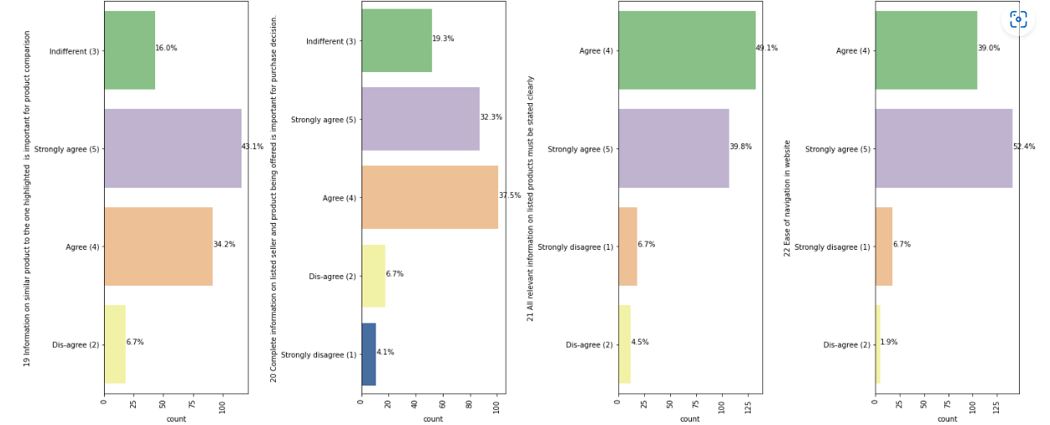
OBSERVATION:

Slide 24
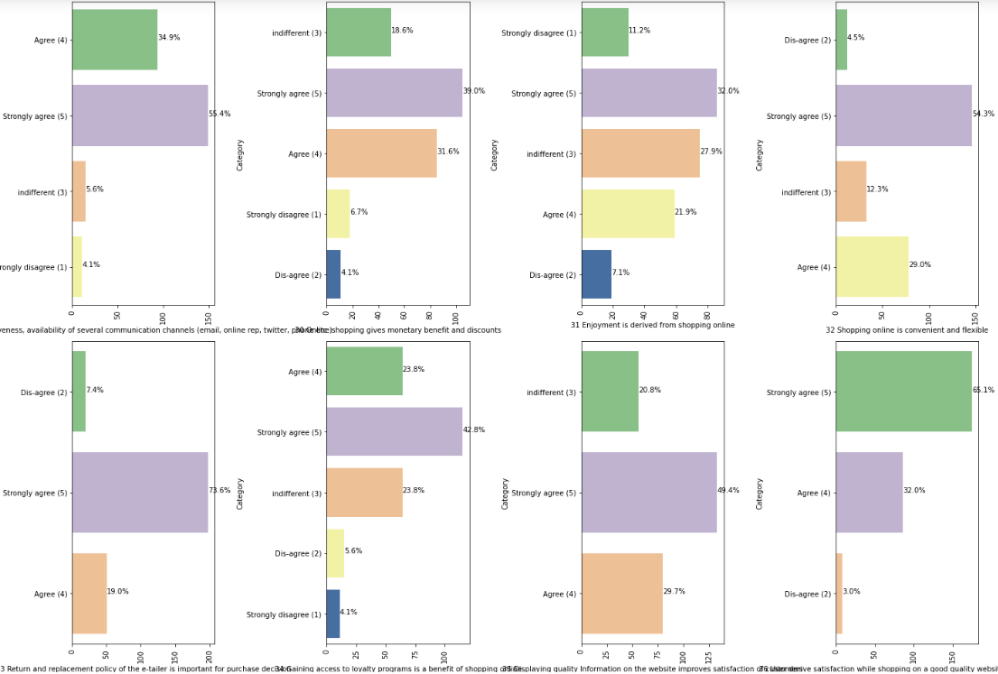

Slide 25
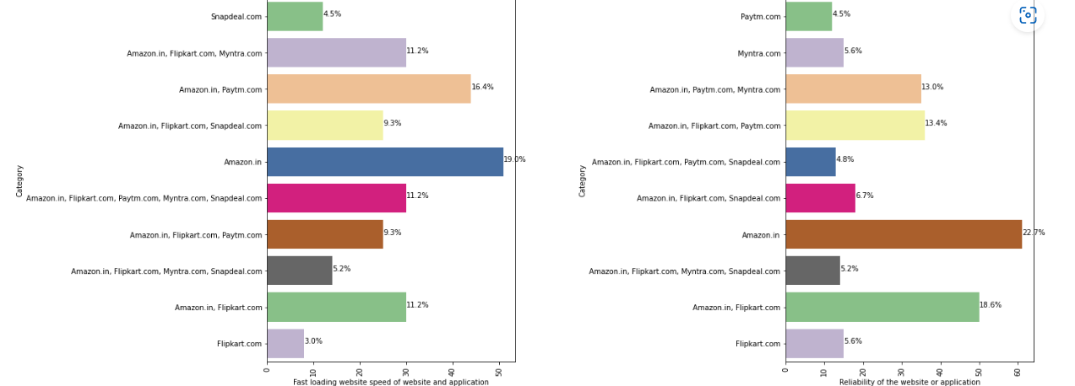

Slide 26
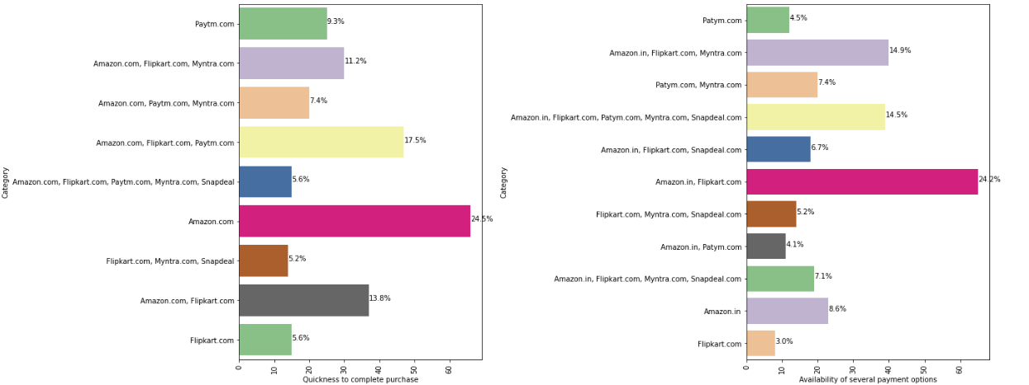

Slide 27
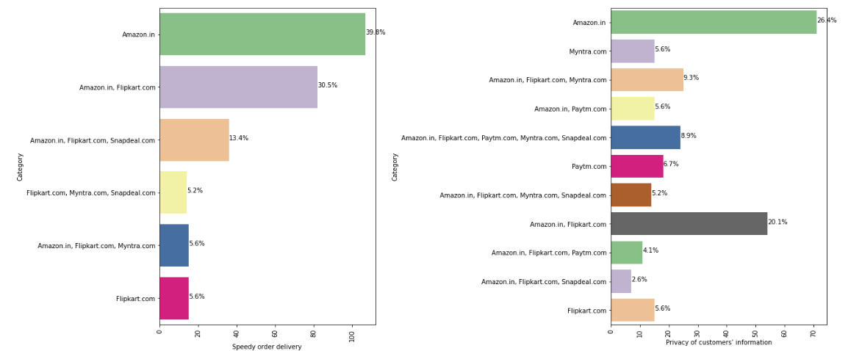

Slide 28
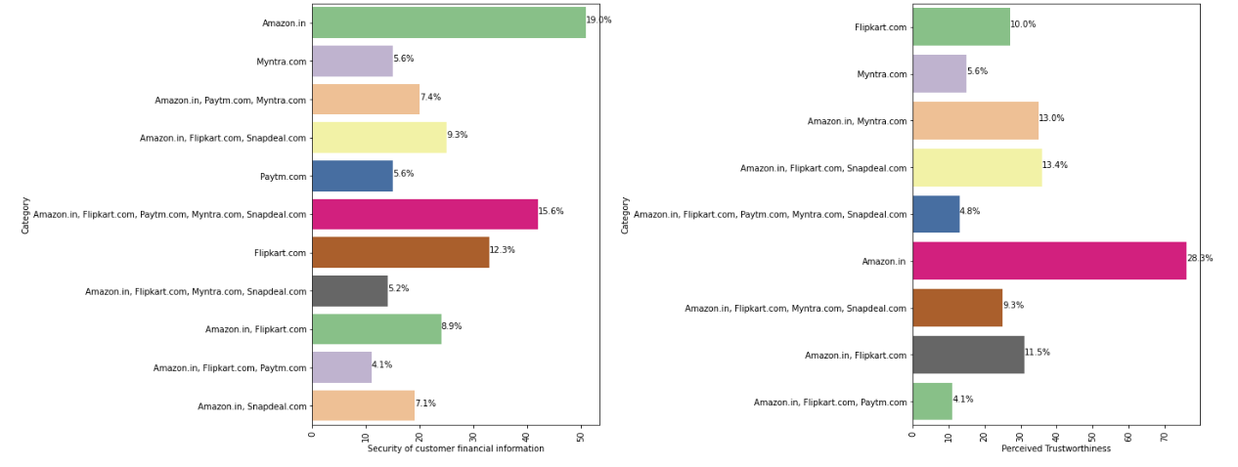

Slide 29

CONCLUSION:

